Slide 1
Announcements

Slide 2
Status report Defenses
Monday – Wednesday – Friday next week (various times)
NB : Those under Ma’am Sandra will give their report to her
1 hour long
Smart Casual
PPT presentation summarizing/highlighting the progress of the group
Q and A
Rubrics

Slide 3
Talk 1 : required
4th Social Entrepreneurship Conference on Technological Innovations and Inclusive Business
Session III : Business Models of Technological Diffusion for Inclusive Development
A number of technological innovations for inclusive development have been designed but due to the absence of a sound business model, a lot of these innovations have proven to be unsustainable. The panel will explore alternative sustainable business models for diffusing technological innovations for inclusive development
Leong Hall, November 21, 2013, 1:30 – 3:00. You may stay for the next session
Need to fill up a form. Please do it now..
A paper will be submitted.

Slide 4

TALK 2 : required

Slide 5
Make-up class
We will have two one and a half-hour session:
Dec. 2 10:30 – 12:00 or 3:30 – 5:00
Dec. 9 10:30 – 12:00 or 3:30 – 5:00

Slide 6

IT Doesn’t Matter
By Nicholas Carr
An Animated View

Slide 7



SCARCITY
COMPETITIVE ADVANTAGE

Slide 8
SCARCITY
HIGH
COMPETITIVE
ADVANTAGE
LOW
UBIQUITOUS

Slide 9

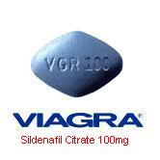


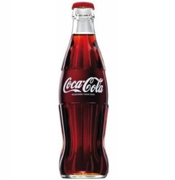



COPYRIGHTS
HIGH
PATENTS
IP
PROPRIETARY
UNIQUE PROCESS
COMPETITIVE
ADVANTAGE
COMMODITIZATION
STANDARDIZATION
LOW
INFRASTRUCTURAL
SCARCITY
UBIQUITOUS

Slide 10



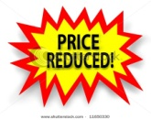



COPYRIGHTS
HIGH
PATENTS
IP
PROPRIETARY
UNIQUE PROCESS
COMPETITIVE
ADVANTAGE
COMMODITIZATION
STANDARDIZATION
LOW
INFRASTRUCTURAL
SCARCITY
UBIQUITOUS

Slide 11

HIGH
PROPRIETARY
COMPETITIVE
ADVANTAGE
Years or Decades
Months
Or Weeks
LOW
INFRASTRUCTURAL
SCARCITY
UBIQUITOUS

Slide 12
Where is IT in all this?

Slide 13



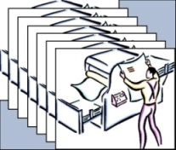
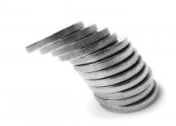


Information
Technology
Characteristics
HIGH
PROPRIETARY
COMPETITIVE
ADVANTAGE
Signs
Capacity
Power
IT
=
commodity suppliers
Price
LOW
INFRASTRUCTURAL
SCARCITY
UBIQUITOUS

Slide 14


HIGH
COMPETITIVE
ADVANTAGE
CONTROVERSIAL !!!
MANAGE COSTS AND RISKS METICULOUSLY
LOW
SCARCITY
UBIQUITOUS

Slide 15
New Rules for IT Management
SPEND LESS
Rigorously evaluate expected returns from IT investments.
Negotiate contracts ensuring long-term usefulness of your investment.
Assess data storage (eliminate waste and non-relevant information).
FOLLOW, DON’T LEAD
The longer you wait to make an IT purchase, the more you’ll get for your money.
Wait for standards and best practices to solidify.
FOCUS ON VULNERABILITIES, NOT OPPORTUNITIES
Focus IT resources on preparing for disruptions and proprietary control.
Notes:
FOLLOW:
Decrease risk of buying flawed or soon-to-be obsolete equipment or applications.
Let impatient rivals shoulder the high costs of experimentation.

Slide 16
Pushing it a bit further…

Slide 17
Greatest IT Risk?
“Most companies spend too much on IT and get very little in return”
Larry ellison
Overspending…
As costs fall, new capabilities rise and business increases reliance
on IT – companies continue to invest resources towards large
investments from big hardware and software suppliers.
Meanwhile…
Vast majority of business PC’s rely on a few simple applications.
Applications are technologically mature.
Applications require only a fraction of computing power.
Corporate networks are storing invaluable information.
Notes:
Invaluable Information Examples:
Saved e-mails
Spam
MP3’s
Video Clips
Computerworld estimates that as much as 70% of the storage capacity of a typical Windows network is wasted.

Slide 18
From Offense to Defense
“When a resource becomes essential to competition but inconsequential to strategy, the risks it creates become more important than the advantages it provides”
- Nicholas G. Carr
Notes:
Focus on IT risks more than the potential for strategic advantages.
Electricity: Cannot rely on electricity for strategic advantage, but a brief lapse in supply can be devastating.
IT disruption can paralyze a company. Examples:
Technical glitches
Obsolescence
Service Outages
Security breaches
Terrorism

Slide 19
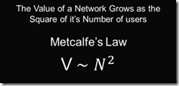
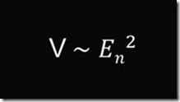
Metcalfe’s Law
Metcalfe's Law states that the value of a network grows in proportion to the square of the number of users (Metcalfe 1996; and Downes, Mui, and Negroponte 1998).
“the value of a network equals the square of the number of networked employees”

Slide 20
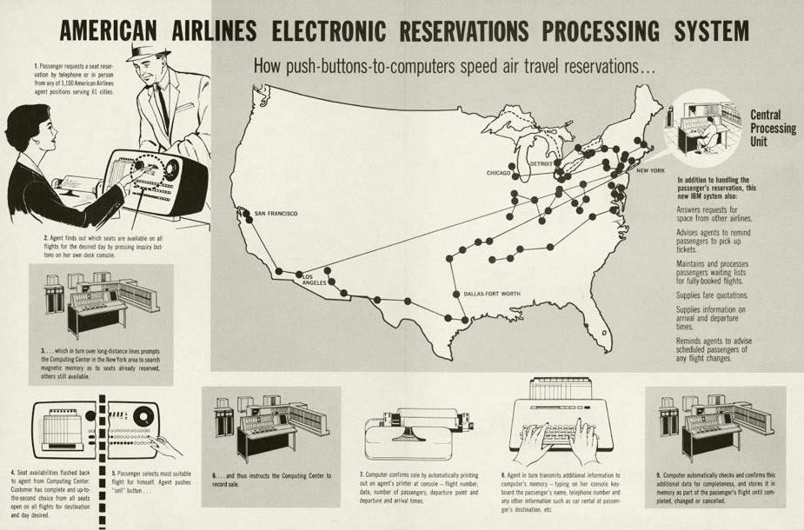
Carr’s Recommendation seems true: Vanishing Advantage
Distinctive IT once provided strong competitive barriers. But barriers have rapidly eroded as accessibility, affordability, and standardization have increased

Slide 21
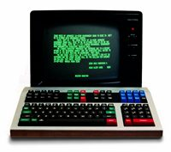
Carr’s Recommendation seems true: Vanishing Advantage
Reuters Monitor, introduced in 1973, provided contributed market information on the foreign exchange to subscribers.
In 1981, they introduced Monitor Dealing where an actual transaction of foreign exchange was done via video terminals
In 1963 the company had made a profit of £51,000; in 1973 profits reached more than £709,000; and in 1981 profits were more than £16 million.

Slide 22
Aren’t There Exceptions?
Yes!
When there are barriers to competitive replication, IT can still act like a proprietary technology.
Idiosyncratic, specialized applications
High copying costs for competitors
Tight ties to unique processes
E.g. Google algorithm, Goldman Sachs derivative apps

Slide 23
But exceptions are rare….
In most companies, 70 – 90% of IT spending goes into maintaining
largely undiferentiated infrastructure

Slide 24
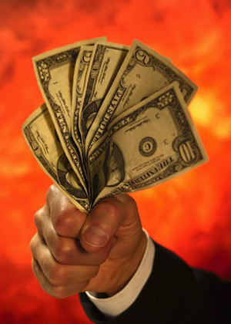
So let’s go back to this equation:
SHAREHOLDER
VALUE
SCARCITY
+
COMPETITIVE ADVANTAGE
INNOVATION

Slide 25
What is innovation?
“the successful exploitation of new ideas” (DTI 2006)
“the successful introduction of a new or improved product, process or service to the marketplace” (SPRU 1972)
“a product, process or service new to the firm, not only new to the world or marketplace” (Hobday 2005)

Slide 26
Innovation and competitive advantage
Strong correlation between new products, capture and retention of market share, and increased profitability
In mature industries, not just low price, but the provision of variety of non-price factors (design, customisation, quality)
Rapid response esp. important given shortening product life cycles

Slide 27
Innovation and strategic advantage
Novelty - Offering something which no-one else can
Competence-shifting - Rewriting the rules of the competitive game
Complexity - Difficulty of learning about technology keeps entry barriers high
Robust design - Basic model product or process can be stretched over an extended life, reducing overall cost
Continuous incremental innovation - Continuous movement of the cost/performance frontier

Slide 28
Types of innovation
Incremental
Small improvements in efficiency and performance within the fixed parameters of one product, business model, institution or practice
Radical
Major changes to the product, business model, institution and especially practices e.g. typewriter, car, computer
Transformative/
Disruptive
Transformation of industry and sectors
Marginal change
Reinforce capabilities in the short term, destroy them in the long term
Mature industries
Destruction or creation of competencies
High uncertainty
Possible transformation of industry and sectors
Change the basis of society
Ford Model T is a transformative innovation (i.e. mass produced technology)

Slide 29
Transformative Technologies
Transformative Technology | Technology it disrupted
3.5 inch floppy | 5.25 inch floppy
Zip drives | 3.Inch floppy
XXXXX | Zip drive
YYYYYY | XXXXXX
 | Rail transport
 | Metal, wood, glass
 | Traditional encyclopedias

Slide 30
Decline
HIGH
4
5
PROPRIETARY
Mature
6
3
COMPETITIVE
ADVANTAGE
Established
PERFORMANCE
2
EMBROYONIC
GROWTH
MATURITY
AGING
Emerging
1
LOW
INFRASTRUCTURAL
SCARCITY
S - CURVE
UBIQUITOUS
Illustrates the introduction, growth and maturation of innovations as well as technological cycles that most industries experience
Notes:
The S-Curve emerged as a mathematical model and was afterwards applied to a variety of fields including physics, biology and economics. It describes for example the development of the embryo, the diffusion of viruses, the utility gained by people as the number of consumption choices increases, and so on.
In the innovation management field the S-Curve illustrates the introduction, growth and maturation of innovations as well as the technological cycles that most industries experience. In the early stages large amounts of money, effort and other resources are expended on the new technology but small performance improvements are observed. Then, as the knowledge about the technology accumulates, progress becomes more rapid. As soon as major technical obstacles are overcome and the innovation reaches a certain adoption level an exponential growth will take place. During this phase relatively small increments of effort and resources will result in large performance gains. Finally, as the technology starts to approach its physical limit, further pushing the performance becomes increasingly difficult, as the figure below shows.

Slide 31
HIGH
PROPRIETARY
COMPETITIVE
ADVANTAGE
Technology B
Technology A
PERFORMANCE
LOW
INFRASTRUCTURAL
SCARCITY
S - CURVE
UBIQUITOUS
Notes:
The S-Curve emerged as a mathematical model and was afterwards applied to a variety of fields including physics, biology and economics. It describes for example the development of the embryo, the diffusion of viruses, the utility gained by people as the number of consumption choices increases, and so on.
In the innovation management field the S-Curve illustrates the introduction, growth and maturation of innovations as well as the technological cycles that most industries experience. In the early stages large amounts of money, effort and other resources are expended on the new technology but small performance improvements are observed. Then, as the knowledge about the technology accumulates, progress becomes more rapid. As soon as major technical obstacles are overcome and the innovation reaches a certain adoption level an exponential growth will take place. During this phase relatively small increments of effort and resources will result in large performance gains. Finally, as the technology starts to approach its physical limit, further pushing the performance becomes increasingly difficult, as the figure below shows.

Slide 32
A Look at Group Buying Sites : Group on and Cash-Cash Pinoy

Slide 33
Tuanguo
“Team Buying” “Group Buying” “Store Mobbing”
Started in China
The strategy allows buyers to get discount prices from a retailer when a large group of people were willing to buy the same item
How does it work?
If subscribers to a discount website are tempted by a discount offer, they enter their payment details online and wait. Once a minimum number of people sign up for the same offer, the deal is confirmed and a voucher is sent to their inboxes. Shops, restaurants and other retailers that partner with these discount websites have to take hefty price cuts. But it means they have instant access to a whole new group of customers.

Slide 34

Groupon negotiates huge discounts—usually 50-90% off—with popular businesses. We send the deals to thousands of subscribers in our free daily email, and we send the businesses a ton of new customers. That's the Groupon magic.
The company offers one "Groupon" ("group+coupon") per day in each of the markets it serves. The Groupon works as an assurance contract : if a certain number of people sign up for the offer, then the deal becomes available to all;^{[19]} if the predetermined minimum is not met, no one gets the deal that day.^{[9]} This reduces risk for retailers, who can treat the coupons as quantity discounts^{[9]} as well as sales promotion tools. Groupon makes money by keeping approximately half the money the customer pays for the coupon.^{[9][20]} So, for example, an $80 massage could be purchased by the consumer for $40 and then Groupon and the retailer would split the $40. -- wikipedia.com

Slide 35

“Mercata, is a group-buying site backed by the venture capital firm of Microsoft co-founder Paul Allen. The site lets shoppers band together to get discounts on items by purchasing them in bulk. Specifically, a user would log in find a product he or she was interested in, and tell Mercata how much they were willing to pay for it. The more pepole who signed up, the cheaper the product got.

Slide 36
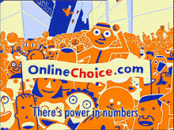

Pittsburgh-based OnlineChoice.com Inc. is an online business that aggregates business and consumer customers to save them money (around 1-5%) on utilities and services. OnlineChoice sells electricity, natural gas, long distance, local telephone service, Internet access, and home security electricity to individuals and small businesses, pooling their purchasing power to negotiate better deals with suppliers.

Slide 37
Question:
Why do you think GroupOn succeeded as against Mercata and OnlineChoice.com – Mercata being the pioneer of Online Group Buying – both of which folded/declared bankruptcy in 2003?

Slide 38


Pushing it further, the Philippines has at least 32 Online Group Buying Sites.
What differentiates one from another?

Slide 39

Officially launched last May 26, 2011
A result of the failed bid of Google to buy out GroupOn.
What makes it different?
Maybe it’s integration with Google Maps and Google Places!
(Shades of “Getting IT Right” – Integrated Platform)

Slide 40
About Business Models
Business models themselves are complex and not well understood – they lack any formal basis that would facilitate both description and comparison.
Linder and Cantrell assert that:
“executives can't even articulate their business models. Everyone talks about business models but 99 percent have no clear framework for describing their model.”
Minimal description
The business model articulates how the business makes money
Linder, J.C., Cantrell, S. (2000): "Changing business models: surveying the landscape", White Paper, Institute for Strategic Change, Accenture

Slide 41
A Business Model….
A business model describes the rationale of how an
organization creates, delivers and captures value!
“There’s not a single business model.. There are really a lot of opportunities and a lot of options and we just have to discover all of them.”

Slide 42
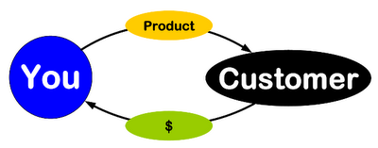
BUSINESS MODEL
How do we deliver value
at an appropriate cost?
What do they value?
Who?
How do we make money?
These are stories that explain how enterprises work

Slide 43
Interesting observations
The most common format for the business model is a single page of narrative text
A business model does not explicitly include implementation technologies
it is driven by business requirements and simply enabled by technology
Articulation of a business model is no guarantee of its success
only implementation will tell if the model works or not
New business models are increasingly viewed as key intellectual property, and often attempts are made to protect them by patent

Slide 44
Extended definition (Perspective 1)
Chesborough and Rosenbloom specify that the 6 functions of a business model are to:
Articulate the value proposition
Identify a market segment, i.e. the users to whom the offering is useful and for what purpose, and specify the revenue generation mechanism for the firm.
Define the structure of the value chain within the firm to create and distribute the offering and determine the complementary assets needed to support the firm’s assets in this chain.
Examine the cost structure and profit potential of producing the offering given the value proposition and value chain structure chosen.
Describe the position of the firm within the value network linking suppliers and customers including identification of potential complementors and competitors.
Formulate the competitive strategy by which the innovating firm will gain and hold advantage over rivals.
Chesborough, Henry; Rosenbloom, Richard: The role of the business model in capturing value from innovation: evidence from Xerox Corporation’s technology spin-off companies, Industrial and Corporate Change, Volume 11, Number 3 pp529-555.

Slide 45
Extended definition (Perspective 2)
Magretta identifies 2 key areas in a business model description
The story
The numbers
Both have to make sense
When business models don't work, it's because they fail either the narrative test (the story doesn't make sense) or the numbers test (the P&L [profit and loss] doesn't add up).
Magretta, J: Why Business Models Matter, Harvard Business Review 2002, Vol 80; Part 5, ISSN 0017-8012, pages 86-93.
Notes:
I

Slide 46
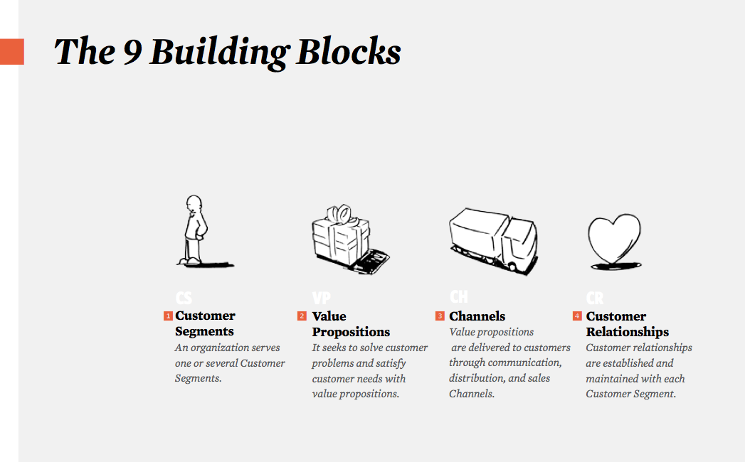
Business Model Canvas (Perspective 3)

Slide 47
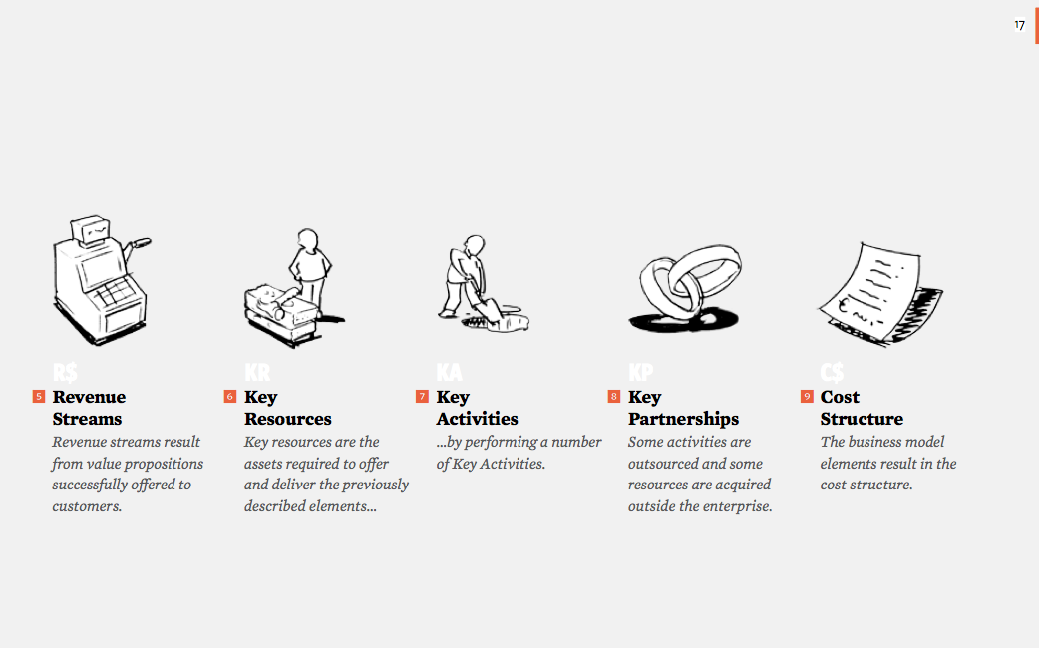
The Business Model Canvas (con’t)

Slide 49
Approaches to Business Model Evolution
Enhance
Extend
Add functionality or features to current
Enter new line of business and/or add new
product/service offerings or improve
business models
performance of existing business
Extend
Enhance
Expand
Exit
Exit
Expand
Exit a business or market or drop a
Add new product/service offerings
product/service offering
or enter new geographic markets

Slide 50
Sources of Images
Slide 2: http://oursoulunited.files.wordpress.com/2010/12/scarcity_abundance.jpg
Slide 2: http://nospillsales.info/wp-content/uploads/2010/12/selling-competition.jpg
Slide 2: http://www.infobarrel.com/media/image/62664.jpg
Slide 4: http://www.doonlinejob.com/wp-content/uploads/2011/08/bag_of_money.png
Slide 4: http://3.bp.blogspot.com/-AVKnBdQi14k/Tiw__mtpgDI/AAAAAAAAAN4/fS_Kvh5VMbo/s1600/price-tag-images.jpg
Slide 4: http://www.featurepics.com/FI/Thumb300/20110226/Price-Tag-Label-1798760.jpg
Slide 4: http://us.123rf.com/400wm/400/400/ppart/ppart0903/ppart090300144/4528568-sale-price-tag-from-red-set-computer-generated-3d-photo-rendering.jpg
Slide 4: http://image.shutterstock.com/display_pic_with_logo/131278/131278,1208503412,4/stock-photo-reduced-price-tag-illustration-11650330.jpg
Slide 4: http://www.responsible-investor.com/images/uploads/articles/green_funds_growth.jpg
Slide 4: http://goodliferetirement.com/wp-content/uploads/2011/07/investment.jpg
Slide 4: http://www.clker.com/cliparts/7/e/6/e/12362679192063758008AX11_factory.svg.med.png
Slide 4: http://dir.coolclips.com/Industry/Distribution/Conveyor_Belts/conveyor_belt_CoolClips_vc038859.jpg
Slide 4: http://l.thumbs.canstockphoto.com/canstock6852908.jpg
Slide 5 : http://3.bp.blogspot.com/-RHSZur174go/TdfhoytSHTI/AAAAAAAAAEA/2X_-QRDgrXE/s1600/IPKat%2B08%2Bamazon_one_click.png
Slide 5 : http://tariqweb.com/wp-content/uploads/2011/07/15.jpg
Slide 5 : http://upload.wikimedia.org/wikipedia/en/thumb/b/bf/KFC_logo.svg/160px-KFC_logo.svg.png
Slide 5 : http://www.ravensturf.com/img/buy-viagra-sildenafil-100mg-online.jpg
Slide 8 : http://www.dur.ac.uk/images/greenspace/smallicons/travel_icon.png
Slide 8 : http://www.lhiprint.com/images/Copies.jpg?653
Slide 8: http://us.cdn4.123rf.com/168nwm/seamartini/seamartini1001/seamartini100100063/6250878-color-graph-for-design-and-business-concept.jpg
Slide 8 : http://stevesbankingsite.com/wp-content/uploads/2010/01/Customer-Service-Provider-300x225.jpg
Slide 8 & 9 : http://adawnjournal.com/wp-content/uploads/2010/04/WhatIsDeflation.jpg
Slide 9 : http://www.1stwebdesigner.com/wp-content/uploads/2009/07/free-twitter-icons/follow-me-twitter-icon-free.jpg
Slide 11 : http://www.munknee.com/wp-content/uploads/2009/10/Purchasing-Power.jpg
Gears : http://www.o2env.com/wp-content/uploads/2010/08/assesment.png

